Slide 1

P peline
The Data
Information Perception
© Jennifer Mankoff
The Data Pipeline; HCII; Spring 2014
Slides cribbed from Marti Hearst http://courses.ischool.berkeley.edu/i247/f05/ Jian Huang, based on a tutorial by Daniel Kiem; Beomjin Kin

Slide 2
Deconstruct this
http://githut.info/
Notes:
Small multiples

Slide 3
Goals
After this, you should be able to:
Understand key visual parameters to use in designing a visualization
Adapted from http://www.fordham.edu/economics/Vinod/correl-regr.ppt

Slide 4
Ware Reading
Support pattern finding capabilities
Optimize cognitive processes as a nested set of activities
Take economies of cognition into account (e.g. cost of learning new representations/tools)
Think about attention at many levels, design around cognitive goals
Notes:
Finding causes of breast cancer: http://www.cabreastcancer.org/causes/

Slide 5
Sensation (physical process) Perception (cognitive process)
Stimulus
Sensory Organ
Perceptual Organ
Brain
Eye

Slide 6
Step 1: Low Level Property Extraction
Stimulus
Sensory Organ
Perceptual Organ
Brain
Eye
Iconic (Pre-attentive) processing
VERY FAST
Parallel Detects basic features Repeats every 200ms (saccades)
Notes:
Very fast
Recognition only
Only good at some things… things you want to stand out should use these capabilities

Slide 7
Pre-Attentive Processing

Slide 8
Step 1: Low Level Property Extraction
Stimulus
Sensory Organ
Perceptual Organ
Brain
Eye
Iconic (Pre-attentive) processing
Type | Attribute | Quantitatively Perceived?
Form | Length | Yes
 | Width | Yes (limited)
 | Orientation | No
 | Size | Yes (limited)
 | Shape | No
Type | Attribute | Quantitatively Perceived?
Color | Hue | No
 | Intensity | Yes (limited)
Position | 2-D position | Yes
Notes:
Very fast
Recognition only
Only good at some things… things you want to stand out should use these capabilities

Slide 9
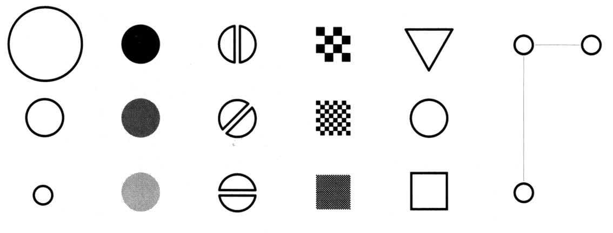
Making Things Distinct
Size
Value
Orientation
Texture
Shape
Position (2D / 3D)
Bertin’s ‘retinal variables’ form the basis for all forms of visual coding. A visual code can be based on (from left to right) contrasts of different types. Hue (chromatic color) provides an addition dimension not shown here.
Kevin Mullet and Darrell Sano, Designing Visual Interfaces
Slide from Marti Hearst/Jeff Heer via Jason Hong
Notes:
Note that while size and other cues provide for quantitative comparison, color (even luminance) only provides for ordering.
If the goal is contrast along any of these axes, make it distinct!
Low level http://vanseodesign.com/web-design/gestalt-principles-of-perception/

Slide 10
What can people easily decode?
Ranked Order:
Position along a common scale (e.g., scatterplot)
Position along identical but non-aligned scales (e.g., table of scatter plots)
Length (e.g., bar chart)
Then angle & slope (pie chart); area (bubbles); volume/density/color (heatmap) and hue
William S. Cleveland and Robert McGill (1984) Graphical Perception: Theory, Experimentation, and Application to the Development of Graphical Methods (J. Am. Statistical Association)
Notes:
Scanning
Recognizing
Remembering images

Slide 11
Color and Quantitative Data

Slide 12
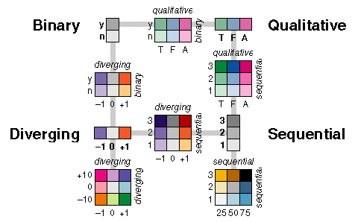
Color Use Guidelines
^{Color Brewer}
^{http://colorbrewer2.org/}

Slide 13
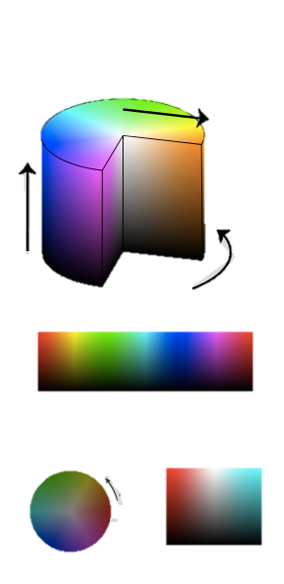
Hue
saturation
Hue – base color
Dominant wavelength of light
value max(R, G, B)
hue
S=1 (constant saturation)
Cylindrical shell at S=1
v
H: 0 120 240 360
V=1/2
H=0 H=180
hue
v
Cylindrical slice
s
Notes:
separate h/s to two dimensions, luminance to the 3rd
more appropriate cognitively.
This is actually cylindrical – hue around the outside (angle) on the web value between 0 and 360 (red is 0, green is 120, blue is 240) and it’s in rainbow order), saturation from center to edge, value is top to bottom
Also web uses HSL. Revisit?

Slide 14
Hue
saturation
Hue – base color
Saturation – purity
Affected by mixing in ‘achromatic’ color (white, gray or black). Saturation is defined as the percentage of pure hue in the color
value max(R, G, B)
hue
h
Cylindrical shell at S=1
v
h
Less saturated
H: 0 120 240 360
V=1/2
H=0 H=180
hue
v
Cylindrical slice
s
Notes:
separate h/s to two dimensions, luminance to the 3rd
more appropriate cognitively.
This is actually cylindrical – hue around the outside (angle) on the web value between 0 and 360 (red is 0, green is 120, blue is 240) and it’s in rainbow order), saturation from center to edge, value is top to bottom
Also web uses HSL. Revisit?

Slide 15
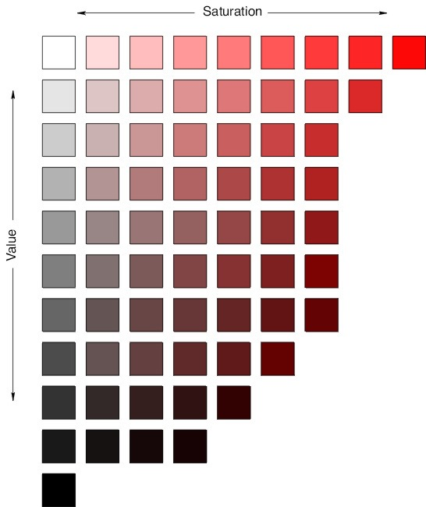
Hue
saturation
Hue – base color
Saturation – purity
Value – Lightness or Luminance
Describes the brightness of a color (how much light appears to be reflected)
value max(R, G, B)
hue
h
Cylindrical shell at S=1
v
h
H: 0 120 240 360
V=1/2
H=0 H=180
hue
v
(Fixed Hue)
Saturation vs. Value
Cylindrical slice
s
Notes:
separate h/s to two dimensions, luminance to the 3rd
more appropriate cognitively.
This is actually cylindrical – hue around the outside (angle) on the web value between 0 and 360 (red is 0, green is 120, blue is 240) and it’s in rainbow order), saturation from center to edge, value is top to bottom
Also web uses HSL. Revisit?

Slide 16
p. 41

Slide 17
In Addition, Perceptual Context Matters
Notes:
Which is darker?

Slide 18
Perceptual Context Matters
Notes:
Which is darker?

Slide 19
Perceptual Context Matters
Large topic – see gestalt psychology readings, e.g. http://vanseodesign.com/web-design/gestalt-principles-of-perception/
Notes:
Which is darker?

Slide 20

Relative Impact of Gestalt Principles Differs
Notes:
Here Proximity trumps similarity (color) while box (common region/enclosure) trumps proximity

Slide 21
Relative Impact Differs
Notes:
& the line & curve trump the similarity: Principal of continuity

Slide 22
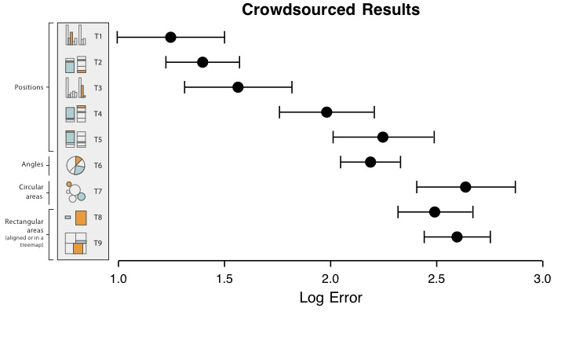

Slide 23
Implications
Use Bar Charts, Line Charts & Scatterplots Skip everything else (most of the time)

Slide 24
Step 2: Pattern Perception
Stimulus
Sensory Organ
Perceptual Organ
Brain
Eye
Working Memory
Long-Term Memory
Slow serial processing; can handle abstraction
Working Memory limited to 3-4 chunks of info
Attention + feature processing
Notes:
Chunks can vary in size
VERY good at recognizing the familiar
e.g. remembering images

Slide 25
Pattern Perception
Problem components are identified & Formed into visual queries
Eye searches the screen, driven by expectations of what to attend to
Query determines what to focus on in each ‘fixation’
Long term memory can guide this
Working memory in play for new things (e.g. legends) – only 3-4 though!
Links to propositions are activated by icons or recognizable patterns

Slide 26
Ware Reading
Support pattern finding capabilities
Optimize for activity at different levels
Outer Loop: Finding candidate visual problems to solve
Pattern testing
Middle Loop: Visual pattern search (eye movements)

Slide 27
Ware Reading
Support pattern finding capabilities
Optimize for activity at different levels
Take economies of cognition into account (e.g. cost of learning new representations/tools)
Saccade: 100ms [50-200]
Cognitive Cycle: 70ms [25-170]
Motor Action: ~70ms [30-100]
Expert action: ~250ms (see/compute/act) Learning: MUCH MUCH slower

Slide 28
Potential Pitfalls
Moving Beyond Perception

Slide 29
Perception Can Also Trick Us
Property | Value
Mean(x) | 9
Variance(x) | 11
Mean(y) | 7.5
Variance(y) | 4.122
Correlation(x, y) | .816
Linear Regression Line | Y = 3 + 0.5x

Slide 30
Mystery Data Set

Slide 31
Mystery Data Set

Slide 32
Mystery Data Set

Slide 33
Mystery Data Set

Slide 34
Mystery Data Set

Slide 35
Numbers won’t catch these diffs
Notes:
I II III IV xy xy
xy
xy
10.00 8.04 8.00 6.95 13.00 7.58 9.00 8.81 11.00 8.33 14.00 9.96 6.00 7.24 4.00 4.26
12.00 10.84 7.00 4.82 5.00 5.68
10.00 9.14 10.00 7.46 8.00 8.00 8.14 8.00 6.77 8.00 13.00 8.74 13.00 12.74 8.00 9.00 8.77 9.00 7.11 8.00 11.00 9.26 11.00 7.81 8.00 14.00 8.10 14.00 8.84 8.00 6.00 6.13 6.00 6.08 8.00
4.00 3.10 4.00 5.39 19.00 12.00 9.13 12.00 8.15 8.00 7.00 7.26 7.00 6.42 8.00 5.00 4.74 5.00 5.73 8.00
6.58 5.76 7.71 8.84 8.47 7.04 5.25 12.50 5.56 7.91 6.89

Slide 36
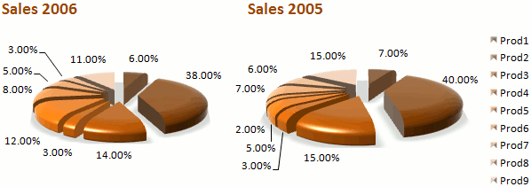
Chart NoNos
Notes:
Wrong type of chart;
Wrong title: doesn’t map to a visual query involving comparison
Too much data
Shouldn’t be sorted alphabetically
Too many different things (reduce to WM)

Slide 37
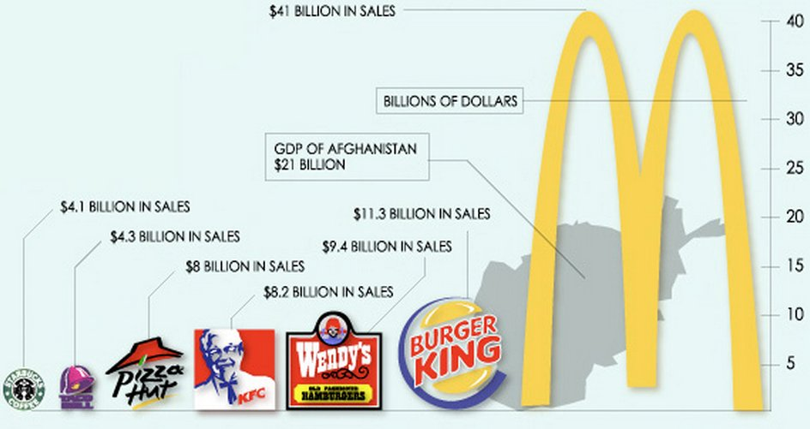
Chart NoNos
Notes:
Burger king is only 3 x starbucks but has 9x the area. People visually favor area over (e.g.) height. Also … chart junk!! Not helping with interpretation…

Slide 38
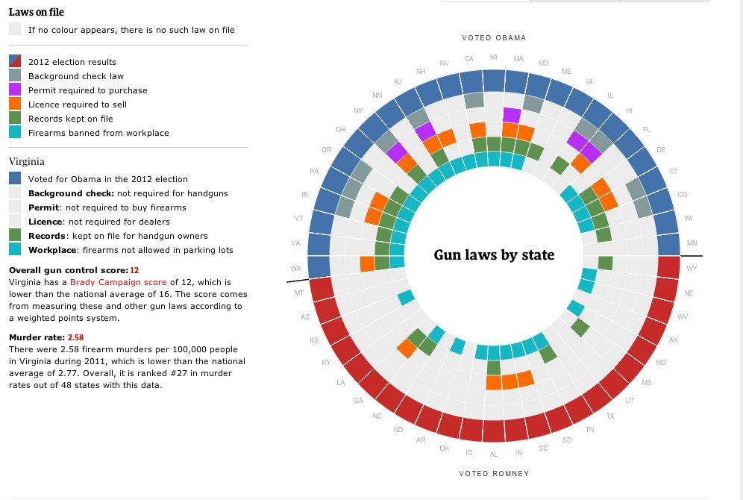
Chart NoNos
Notes:
Shouldn’t even be a chart – table would be better here. Not actually displaying numerical data!

Slide 39
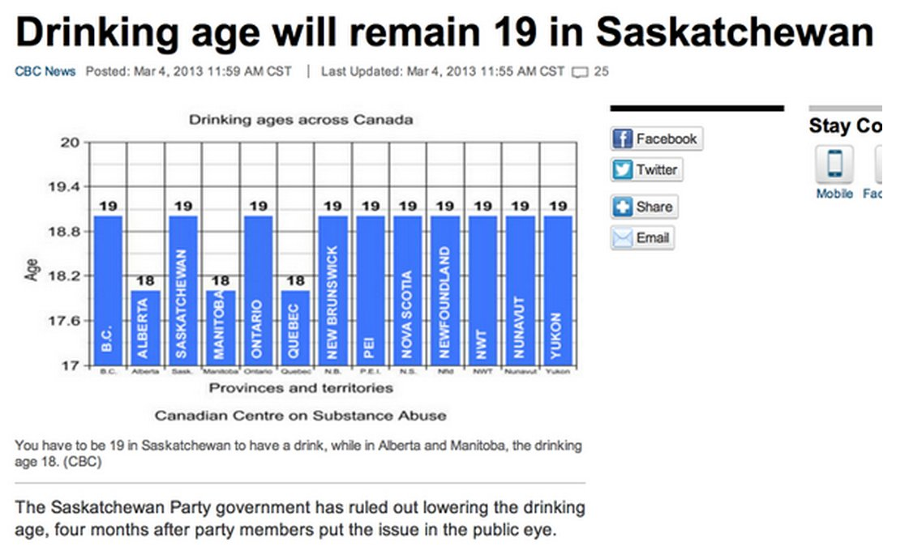
Chart NoNos
Notes:
Nonstandard y axis divisions No real numerical data here

Slide 40
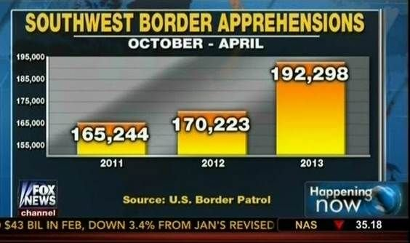
Chart NoNos
Notes:
Y axis doesn’t start at 0 ….
Also arbrarily selected months from 3 different years (arrests have actually gone down since 2008)

Slide 41
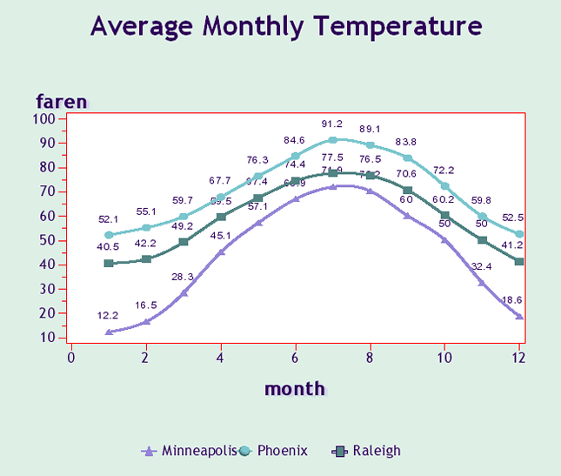
Chart NoNos
Notes:
Overly complex
Legend far from details(more time consuming to process)
Region around graph emphasized
Y axis doesn’t start at 0

Slide 42
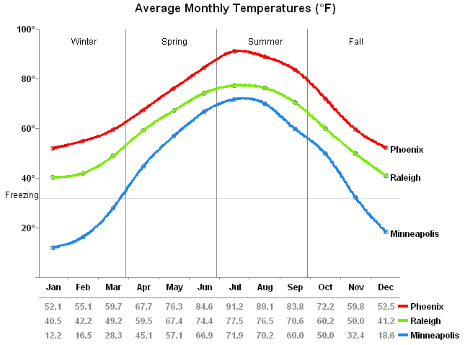
Chart NoNos
Notes:
Improved & Simplified
More information (seasons & freezing point)

Slide 43
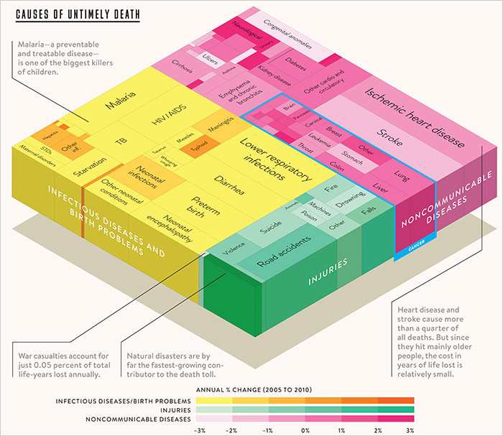
Chart NoNos
Notes:
Gates liked: I love this graph because it shows that while the number of people dying from communicable diseases is still far too high, those numbers continue to come down. In fact, fewer kids are dying, more kids are going to school and more diseases are on their way to being eliminated. But there remains much to do to cut down the deaths in that yellow block even more dramatically. We have the solutions. But we need to keep up the support where they're being deployed, and pressure to get them into places where they're desperately needed.
Key thing missing: negative vs positive change

Slide 44
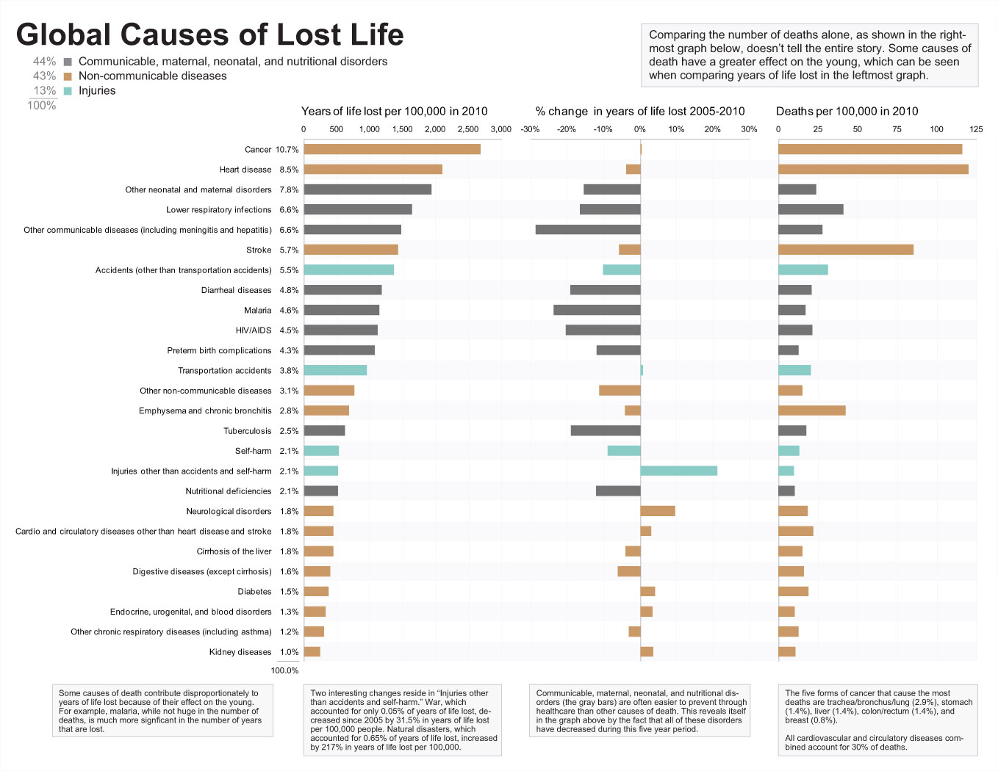
Chart NoNos
Notes:
This really highlights negative vs positive
Also aggregated things (like different types of cancer or heart disease)

Slide 45
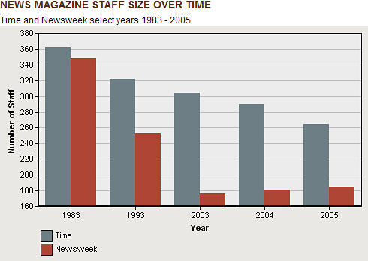
Chart NoNos
Notes:
A bar chart seems fine but misrepresents the truth
Axis doesn’t start at 0
Not a continuous range of time (look at x axis)

Slide 46
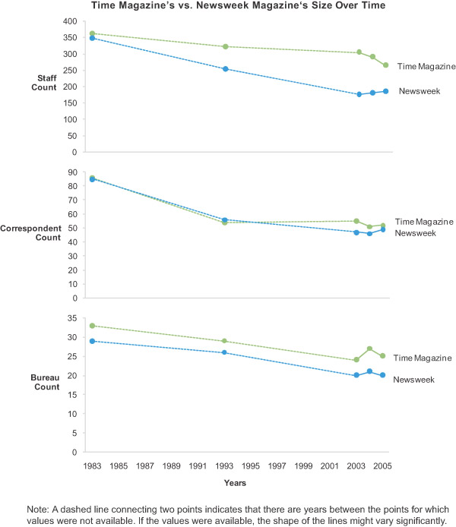
Chart NoNos
Notes:
Much clearer…

Slide 47
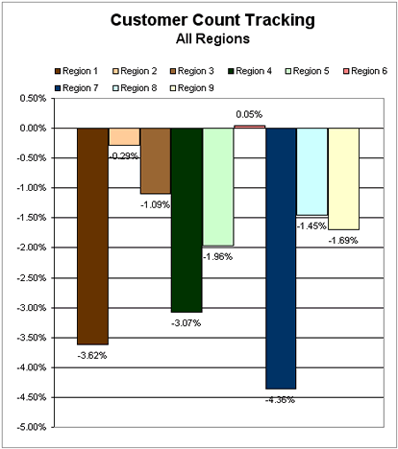
Chart NoNos
Notes:
Hard to get a sense of how different regions are performing
-- hard to map bars to regions
-- chart appears cluttered
-- comparison difficult

Slide 48
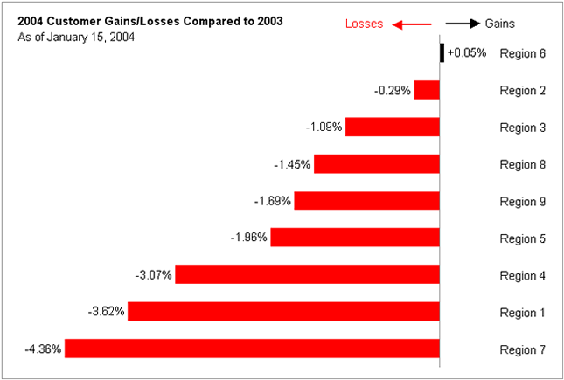
Chart NoNos
Notes:
Red for losses, black for gains
Sorted!
Minimalistic

Slide 49
Chart NoNos
Other great examples
Table vs chart: https://www.perceptualedge.com/example8.php
Infographic vs charts:
https://www.perceptualedge.com/example15.php
An argument about infographic design:
https://www.smashingmagazine.com/2011/10/the-dos-and-donts-of-infographic-design-revisited/
Notes:
Red for losses, black for gains
Sorted!
Minimalistic

Slide 50
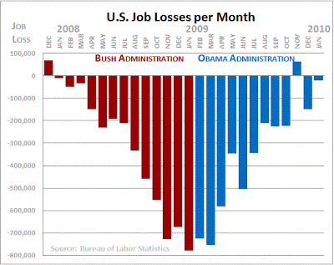
And one last sequence
Notes:
A preview of narrative perhaps?
Actually this shows CHANGE in the data not the present state. if the unemployment rate remains unchanged at 5%, 50%, or even 100%, the monthly change in unemployment is zero. Actual unemployment is not zero, just the monthly change in unemployment.

Slide 51
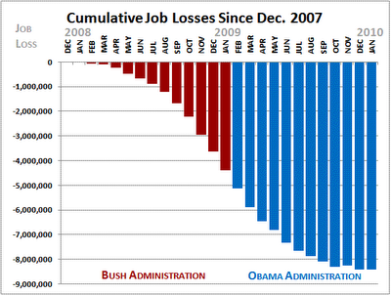
An alternative view
Notes:
more clearly shows that unemployment increased over time and has not returned to December 2007 levels. While it is good news that monthly job losses have slowed (what the Organizing for America chart actually shows), the unemployment situation has not miraculously disappeared (what the Organizing for American chart seems to imply).

Slide 52
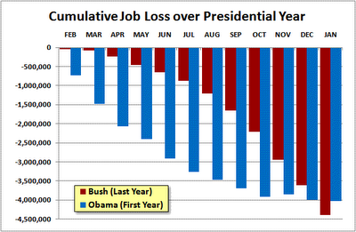
An alternative view
Notes:
Another alternative… compares last year of bush presidency and first year of obama... You can see that Obama’s are worse than bush’s

Slide 53
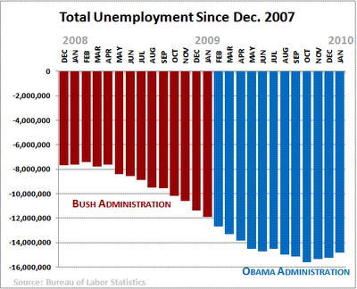
An alternative view
Notes:
Includes already unemployed

Slide 54
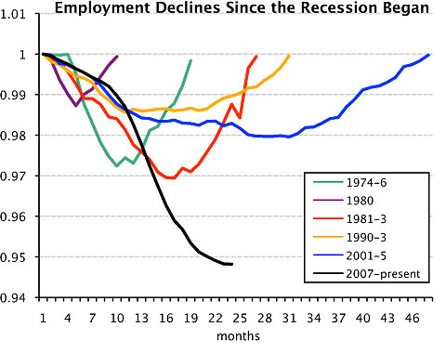
An alternative view
Notes:
Compares to other recessions

